Slide 1
Project Proposal
On
Hospital Management
System
Guided By:-
Anuj Kumar
Created By:-
Name: Monish,
lucky
AFId :AF04992124,
AF04991795
Batch Code:ANPD2405
Course Code:ITPR

Slide 2
Table Of Contents
1.Title Of The Project…..
2.Introduction….
3.Objective….
4.Category
5.Analysis
a.Modules and Description
b.Database Design
c.ER Diagram
d.Data Flow Diagram
6.Complete Structure
a.Process Logical Diagram
7.Platform Used
a.Hardware Requirement
b.Software Requirement
8.Future Scope
9.Biblography

Slide 3
Hospital Management System - Complete Project Report
Title of the Project
Hospital Management System
Introduction
The Hospital Management System (HMS) is a computerized system designed to simplify and digitalize the internal processes of a hospital. It manages essential data such as patients, doctors, staff, medicines, and appointments. Manual hospital operations involve large volumes of paperwork which often lead to errors and delays. HMS eliminates these issues by providing a centralized and efficient database system that improves data accuracy, reduces time consumption, and enhances patient service quality.
Objective
The main objectives of this project are:
To maintain accurate patient records and medical information
To handle doctor details, specializations, and availability
To manage staff roles and their activities efficiently
To automate appointment scheduling between patients and doctors
To track medicine inventory, stock levels, and expiry dates
To ensure quick data retrieval and generate useful reports
To reduce manual workload and human errors
To streamline hospital operations through a user-friendly system
Project Category
Database Management System (DBMS) Application
Analysis - Modules and Description
Patient Module – Manages patient information such as personal details, medical history, and treatment details.
Doctor Module – Stores doctor details including specialization, experience, and availability.
Staff Module – Maintains information about nurses, technicians, and administrative staff.
Medicine Module – Tracks medicine stock, expiry dates, suppliers, and usage.
Appointment Module – Manages appointments between patients and doctors with status updates.
Database Design
Database Tables:

Slide 4
PATIENT Table Design
Fields Datatypes Properties
Patient_Id varchar(50) Primary key ,not null
Name varchar(100) not null
Age int not null
Gender varchar(10) not null
Phone no int not null
DOCTOR Table Design
Fields Datatypes Properties
Doctor_Id varchar(50) Primary key ,not null
Name varchar(100) not null
Specialty varchar(100) not null
Gender varchar(10) not null
Phone no int not null
APPOINTMENTS Table Design
Fields Datatypes Properties
Appointment_ID int primary key,not null
Patient_ID varchar(50) not null
Doctor_ID varchar(50) not null
Appointment_date date not null

Slide 5
MEDICINES Table Design
Fields Datatypes Properties
Id varchar(50) primary key , not null
Name varchar(50) not null
Cost int not null
Details varchar(100) not null
BILLS Table Design
Fields Datatypes Properties
Id varchar(50) primary key , not null
Patient_id varchar(50) not null
Amount int not null
Details varchar(100) not null
Bill_date date not null
STAFF table design
Fields Datatypes Properties
Staff_Id int Primary key ,not null
Name varchar(100) not null
Specialty varchar(50) not null
Gender varchar(10) not null
Phone no int not null

Slide 6
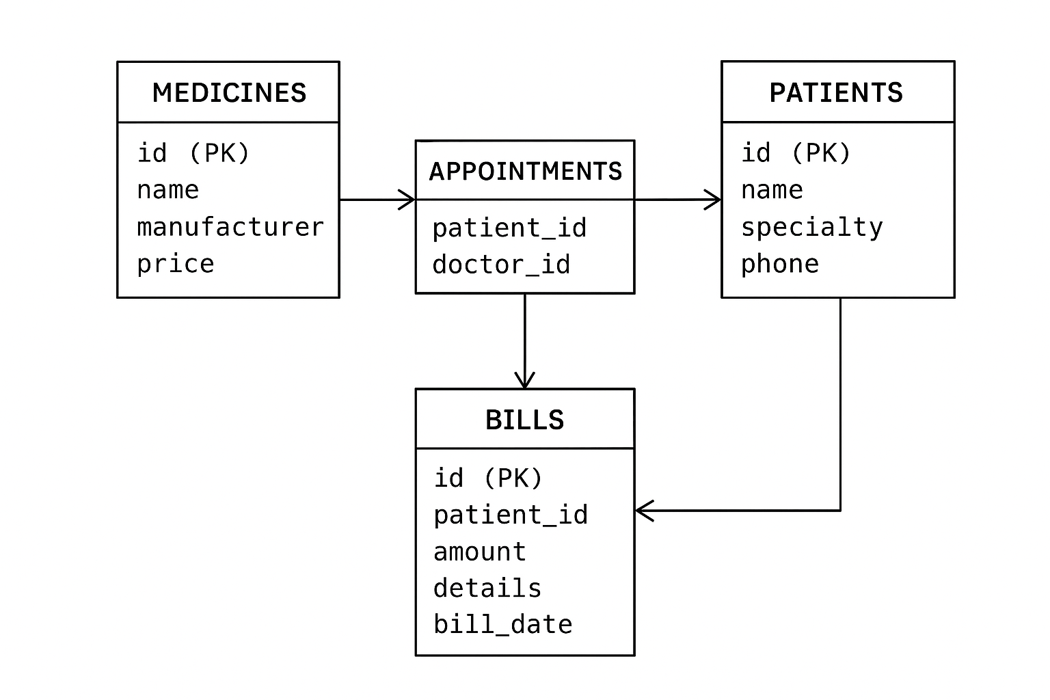
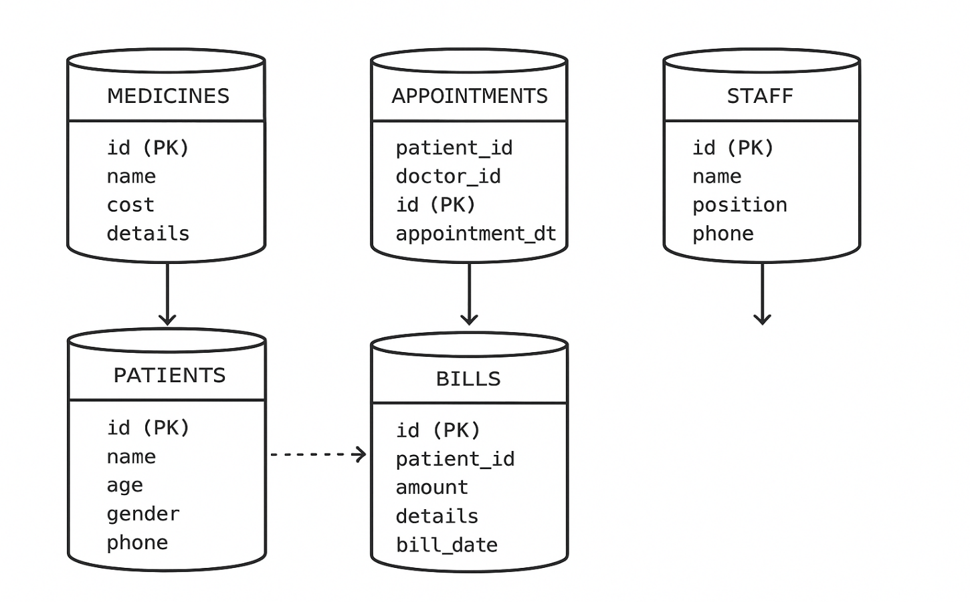
ER Diagram

Slide 7
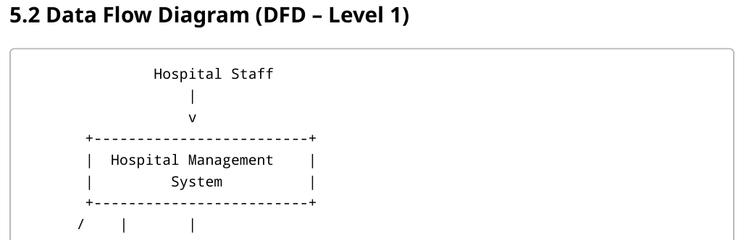
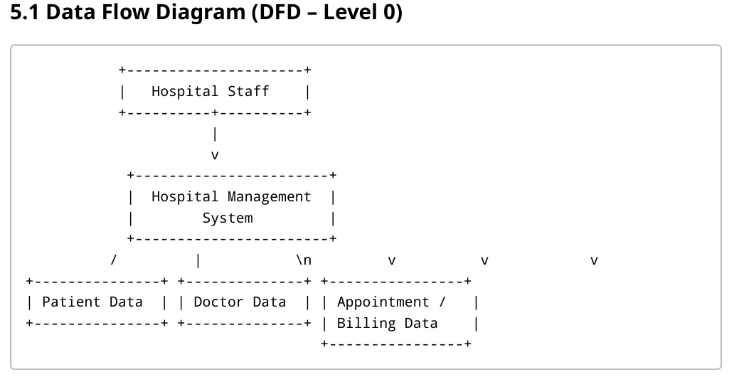
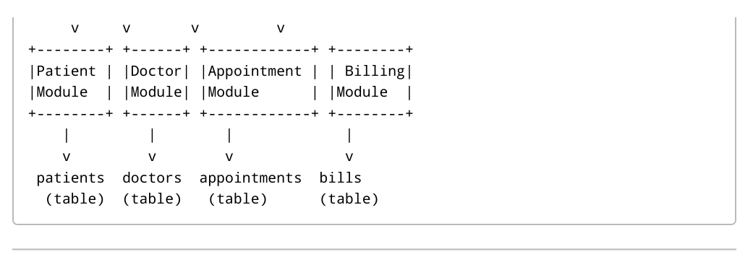
Data Flow Diagram (DFD)

Slide 8
Complete Structure - Process Logical Diagram
Patient  Appointment  Doctor Doctor  Treatment  Medicine
Staff  Support Tasks  Patient Care
Platform Used - Hardware Requirements
Processor: Dual Core or higher
RAM: Minimum 4GB
Hard Disk: 500GB or more
Display: Standard Monitor
Platform Used - Software Requirements
Operating System: Windows / Linux
Database: MySQL / SQL Server
Frontend: Java / Python / PHP / .NET
Tools: XAMPP / VS Code / Eclipse
Future Scope
Online appointment and patient portal
Billing and insurance integration
SMS/Email alerts
Online prescription and medical reports
Mobile app integration
AI-based diagnosis support
Bibliography
Database System Concepts – Silberschatz
Fundamentals of DBMS – Korth
Online documentation and technical references
Software Engineering Guides

